Slide 1
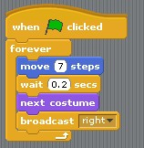
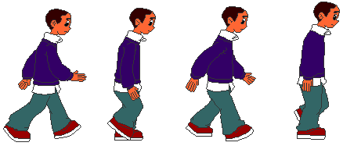
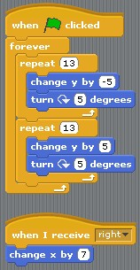
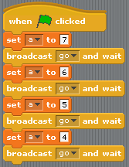
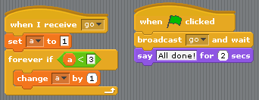
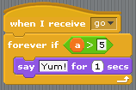
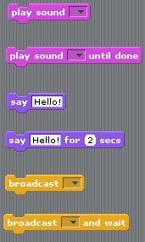
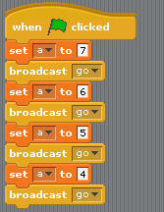
Accelerators to Applications
Supercharging the Undergraduate Computer Science Curriculum
Our theme in introducing parallelism and distributed computing (PDC) concepts into our curriculum is to focus on integration, as opposed to insertion. Historically, any PDC content in an undergraduate curriculum appeared in the context of operating systems, and perhaps algorithms or an upper-level elective. It is undeniable that PDC is of such significance today that it cannot be relegated solely to such courses. Here, we outline our methodology and experiences of integrating PDC into undergraduate courses at various levels, in connection with the proposed core curriculum on PDC. We show that each course carries ample opportunities to consider PDC in a manner that is both level-appropriate and in harmony with the traditional topics of the course.
CS0 or Computer Literacy
General Elective
CS1 First Year
(core)
CS2+ Core Data Structures
1st/2nd Year (core)
Additional Courses
Syllabus
Programming in Scratch – variables, loops, if statements, objects
Parallelism – terminology, history, physical activities [1] and demonstrations
Excel – practical applications for business and finances
Access – introduction to relational databases and queries
Curriculum Initiative Topics
Architecture: Multicore (K)
Programming: Fixed number of processors (K)
Programming: Critical regions (K)
Algorithms: Scalability (K)
Algorithms: Broadcast (C)
Algorithms: Asynchrony (K)
Integration
Scratch provides an easy framework for exploring concepts of parallel computing
Syllabus
Programming in Python – variables, input/output, loops, strings, if statements, objects, classes, parallelism, basic data structures and algorithms, abstraction
Curriculum Initiative Topics
Architecture: Multicore (K) Message passing (K)
Programming: Client/Server (C) Fixed number of processors (K) Critical regions (C)
Integration
Use multiprocessing as a medium for core
Python multiprocessing – minimal syntax!
Fork, join, communication, locks
Medium for: classes and objects, parameter passing, modularity and abstraction, searching and sorting, pattern matching, clustering, simulations
Do what you usually do, just do (some of) it in parallel.
Syllabus
Programming in Java - OOP, Swing, basic algorithm analysis, generics, recursion
Data structures – lists, stacks, queues, trees, maps, heaps, priority queues, graphs
Parallelism – Java ForkJoin Framework, as described in [2].
Curriculum Initiative Topics
Programming: Shared memory (A), Client server (K), SPMD (C), Data parallel (A), Parallel loop (C), Language extensions (A), Libraries (C), Tasks and threads (C), Computation (C)
Cross Cutting: Concurrency (K), Power(K)
Integration
Parallelism is a medium for core CS2 topics
Java Fork/Join Framework (Java 7)
Recursion (divide and conquer), trees and stacks (understanding recursion and forking processes), Java generics, time and space considerations, inheritance, parameter passing and shared memory, exception handling
Additional Courses Under Development
Programming Languages
Computer Hardware
Computational chemistry
Bioinformatics
For More Information Contact
Steve Bogaerts (sbogaerts@wittenberg.edu)
Kyle Burke (kburke@wittenberg.edu)
Brian Shelburne (bshelburne@wittenberg.edu)
Melissa Smith (smithmc@clemson.edu)
Eric Stahlberg (estahlberg@gmail.com)
Using Scratch for Parallel Computing Concepts
Blocking versus non-blocking commands
Advanced Data Structures and Algorithms
3rd/4th Year (core)
Computational Modeling
1st/2nd year (elective)
Acknowledgements
Syllabus
Algorithm analysis, brute force, divide-and-conquer, transformations, space and time tradeoffs, dynamic programming, greedy algorithms, iterative improvement
Curriculum Initiative Topics
Algorithms: Costs of computation (A) Asymptotics (A), Time(A), Space(A), Speedup(A), PRAM(A), Divide and Conquer(A)
Integration
Use of Chapel as an easy language to pick up for this work
Pattern throughout course of sequential algorithm followed by parallelization
Example applications: reductions, parallel merge sort
Syllabus
Computational modeling as an integration of natural science, computer science, and applied mathematics
Experimental methods, simulation, dimensional analysis, visualization, optimization
Computer implementations primarily in Mathematica
Integration
Mathematica Parallel Computing Toolkit gives built-in parallel programming primitives
Exercises in reductions, matrix operations, parallel plotting of data
To be tried for the first time spring 2012.
We gratefully acknowledge the support of the National Science Foundation
Grant CCF-0915805,
SHF:Small:RUI:Collaborative Research:
Accelerators to Applications – Supercharging the Undergraduate Computer Science Curriculum.
For more information visit www.accel2apps.org

